Slide 2


Spot Bonus
Program overview

Slide 3

Agenda
What is a Spot Bonus?
Why is this happening?
Who is eligible?
How does this thing work?

Slide 4
A spot bonus is a spontaneous reward to recognize employees for exceptional performance, achievement and/or contributions that go above and beyond normal job responsibilities.
What?

Slide 5

Why?
Recognizing excellence – it isn’t about doing your job well— it's about going above-and-beyond that makes a noticeable difference!
Boost motivation and engagement – Knowing that hard work is noticed and rewarded motivates employees to keep striving for excellence.
Promotes teamwork & a positive work environment – Great teams aren’t built on individual success alone—top performers help others succeed, and Spot Bonuses acknowledge that.
Improve workflow – Incentivizes innovation and efficiency

Slide 6

Eligibility Criteria
Creative Problem Solving – Resolving a critical issue with a project that could have caused major delays.
Going Above & Beyond – Identifying and implementing process improvements (e.g., new protocols or troubleshooting techniques that benefit the entire team).
Taking the Lead – Volunteering or stepping up to take on extra work where help is needed.
Workflow Optimization – Enhancing efficiency and streamlining operations.
Mentorship & Training – Assisting in onboarding a new team member or creating resources that reduce training time.

Slide 7

Who can qualify?
Employees who go above and beyond their normal job responsibilities in ways that significantly impact the team or company.
Managers cannot be nominated by direct reports, as recognizing their performance falls within leadership responsibilities. However, managers' peers or their own managers may nominate them.

Slide 8
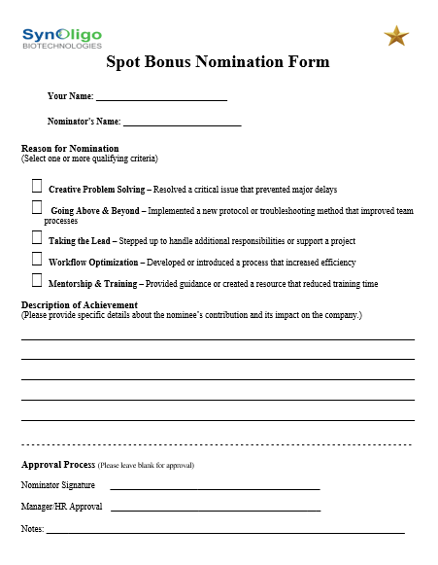
Nomination Process
Nomination forms will be available in the General folder for all to access.
Once filled out, they can be delivered to HR@Synoligo.com
Forms will be evaluated based on observed actions and measurable outcomes. They will then be reviewed to ensure fairness and consistency, and final decisions are made within two weeks of submission.

Slide 9

BUILDING A CULTURE OF RECOGNITION
If you see something, say something!- When you notice a colleague making a meaningful impact, nominate them.
Recognition strengthens team morale and motivates employees to go the extra mile.
A culture of appreciation leads to higher engagement, innovation, and collaboration.

Slide 10

Go Team!
Any Questions?
Feel free to reach out to Xibo

